Slide 1
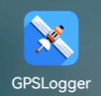
利用GPSLogger记录坐标分析手机定位精度
Notes:
https://learnosm.org/en/mobile-mapping/gpslogger/#%E2%80%8Buploading-traces

Slide 2
利用GPSLogger记录坐标分析手机定位精度步骤
Android手机安装“GPSLogger for Android”
设置GPSLogger参数
在固定的点上记录数据
传输数据
对数据坐标进行分析
QQ群文件有个gpslogger_133.apk
Notes:
The General options is where to find settings for Start on bootup, unit of measurement (Metric or Imperial), debug file and version information.
The Logging details is where to find settings File formats (multiple formats simultaneously supported), folder path to store logs, rules on new file creation and custom file name.

Slide 3
Featres
Specify logging based on time or distance intervals
GPS accuracy filter to not log unreliable points
Select wifi, Cellphone tower and/or GPS satellites as location information source
Log to GPX, KML, CSV, TXT or NMEA files with ZIP support
Auto start on boot
Can run in background
Automatic sending to email/FTP/DropBox/Google Docs/OpenStreetMap/OpenGTS at user defined intervals

Slide 4
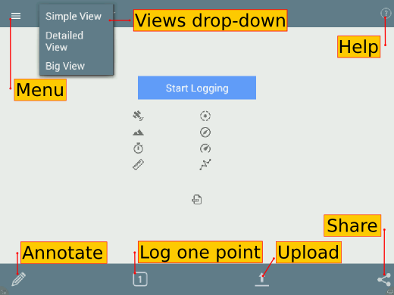
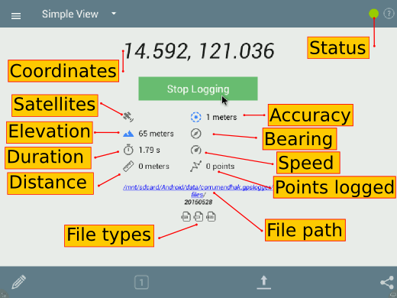
User Interface
Notes:
The Menu button provides more options for configuring the app. The Views drop-down lets you to choose how information is display on the screen. The Help button provides additional information about how to use the app. The Annotate button lets you to add a description to a point. Log one point button lets you manually log a waypoint. Upload lets you choose from a variety of options for uploading your log file. This includes an option to auto send to any of the following:
OpenStreetMap,Google Drive,DropBox,an FTP server,an OpenGTS server orsend the log to an email address.
The Share button lets you choose one or more log files you can share with other people via Bluetooth, or SMS. Depending on what apps are installed on your device, you may have different options available for you.
The Start Logging button is in blue. When you press this button to start recording, it turns to a green button. The Coordinates displays the last recorded GPS point, and is refreshed when a new coordinates become available. The Satellites icon will show you how many satellites you are fixed on. The Elevation shows elevation data. The Duration displays the total time elapsed since pressing the start button. The Distance will display the total distance recorded. The File Types indicate what type of logs are being generated while the File Path tells you where the location of the file in your device or memory card. The Status indicator will display in green when it is recording, while a spinner is displayed when the device is trying to get a fix. The Accuracy will display the accuracy of the recorded data, which varies between receivers, the position or number of available satellites, weather condition, or the obstructions of the horizon. The Bearing tells you the direction you are moving. The Speed will give you approximate information of how fast you are going. Points logged will display the total number of poins recorded from the time the start button was pressed.

Slide 5
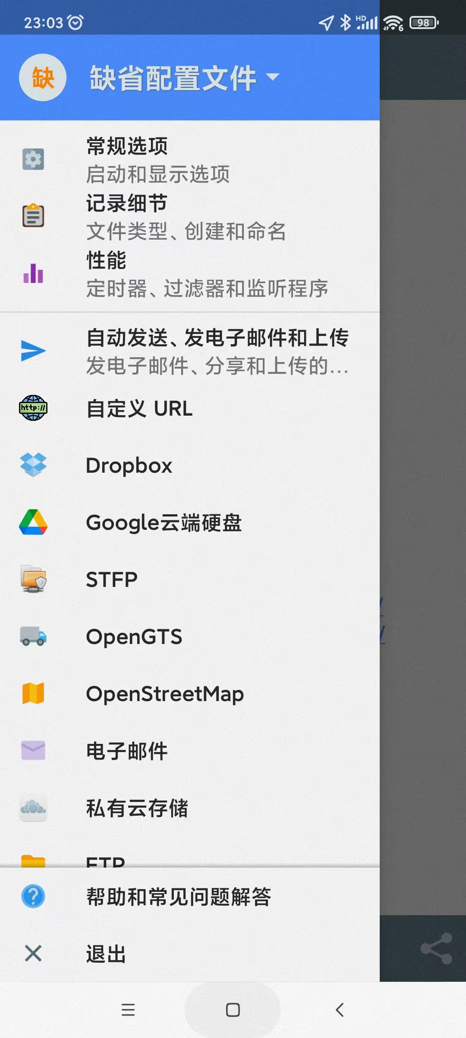

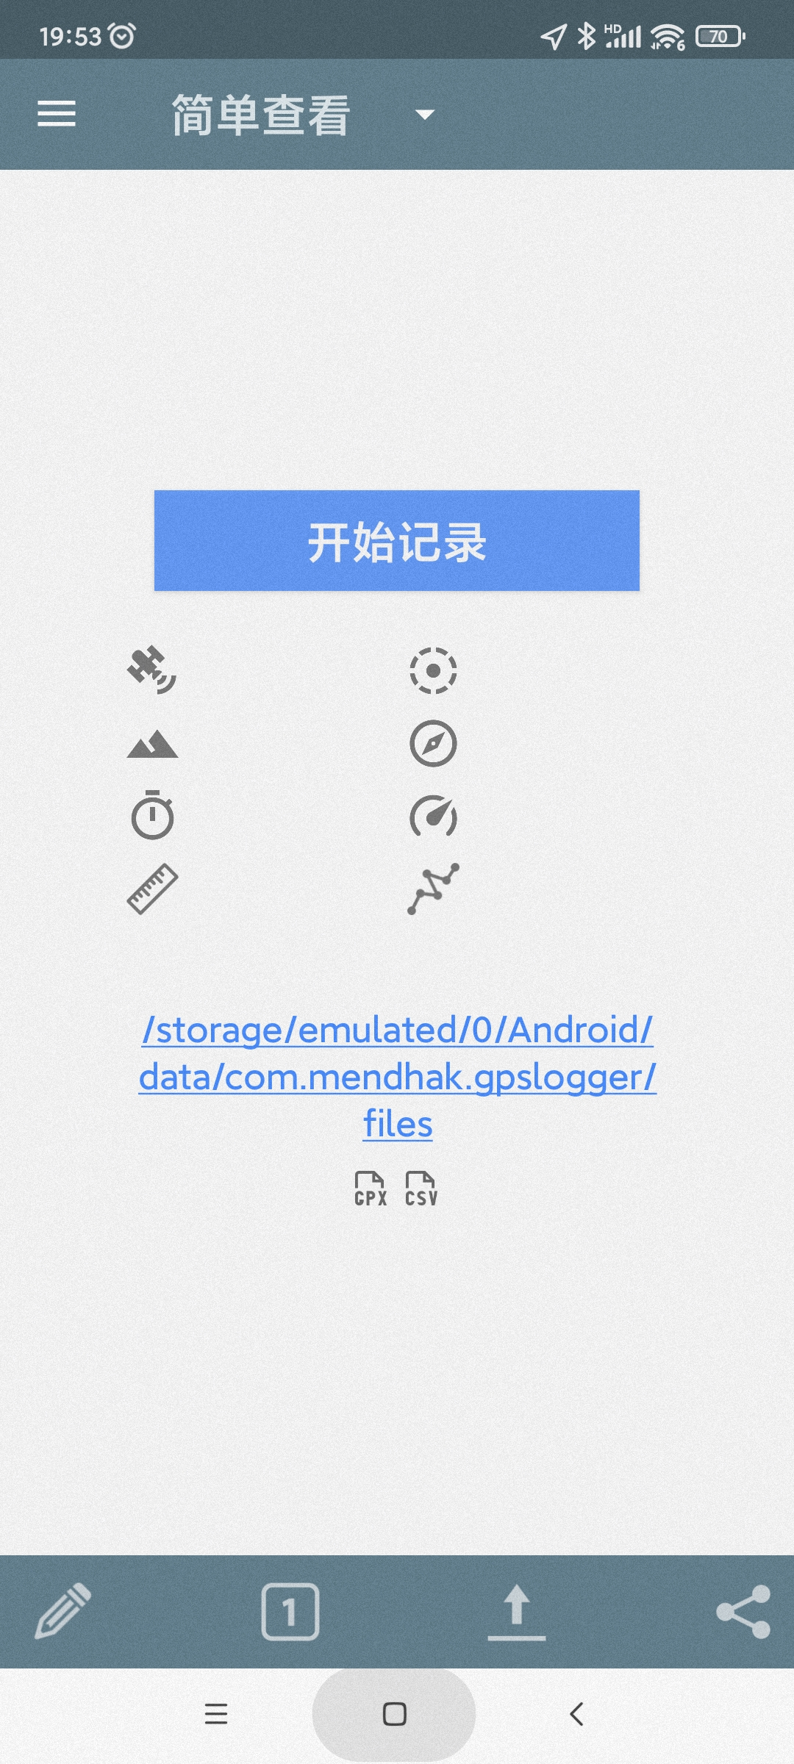
设置GPSLogger参数

Slide 6
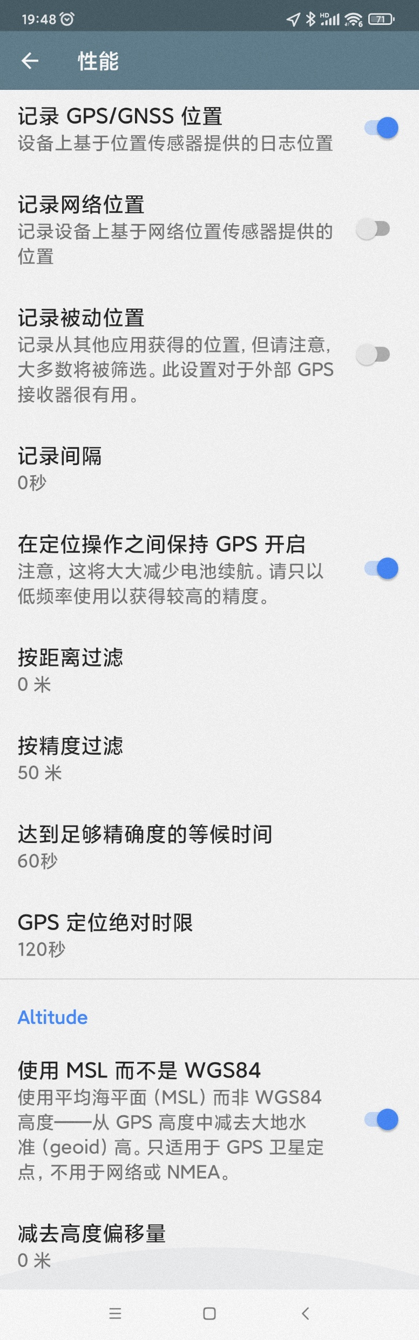
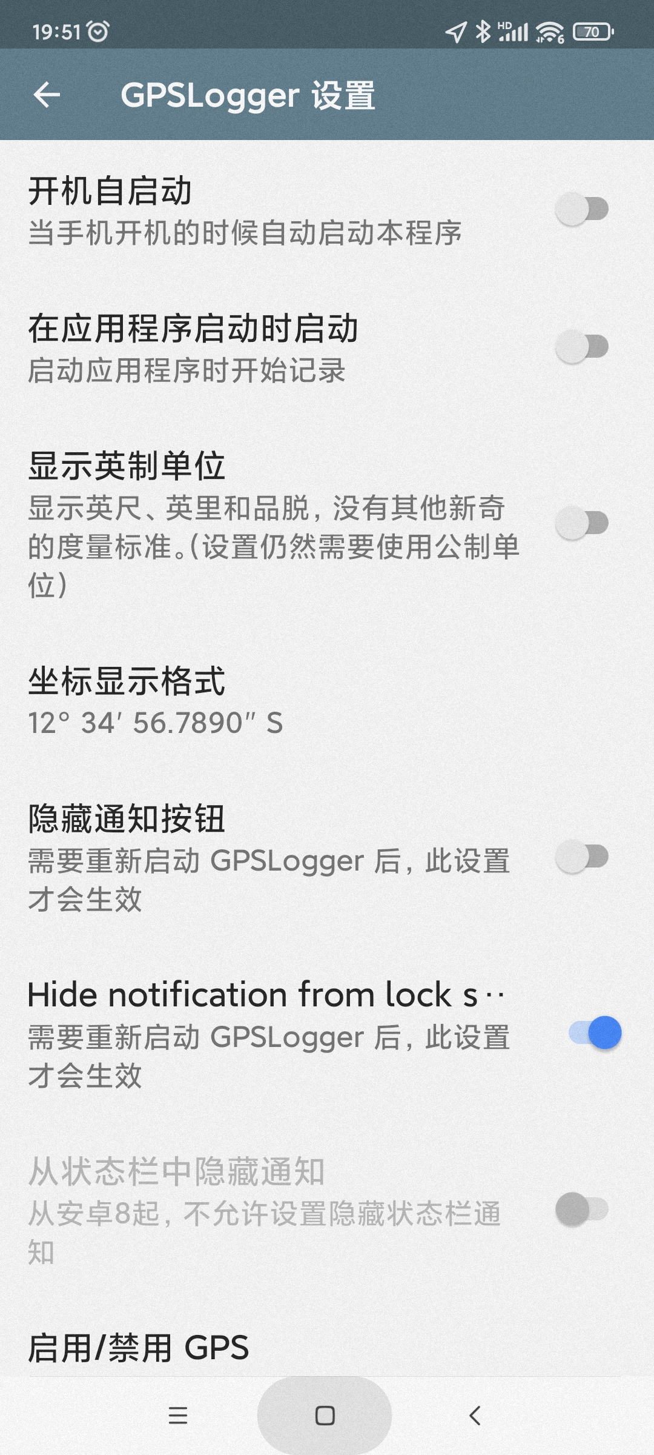
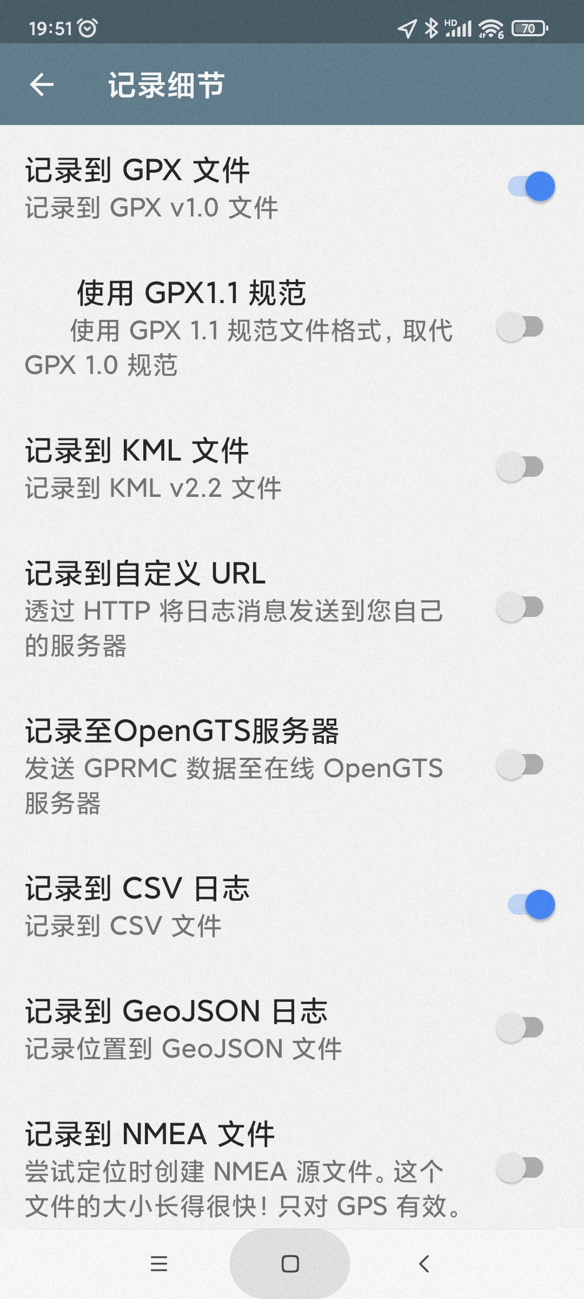
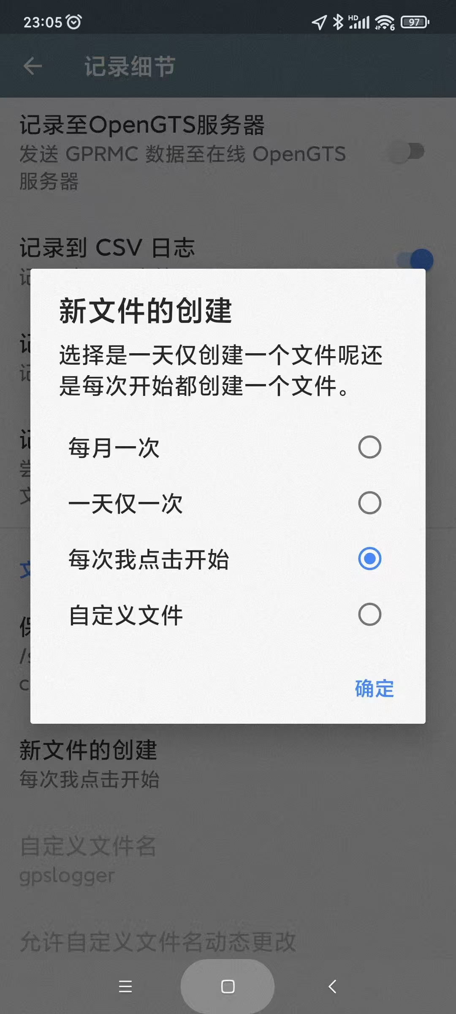
设置GPSLogger参数

Slide 7
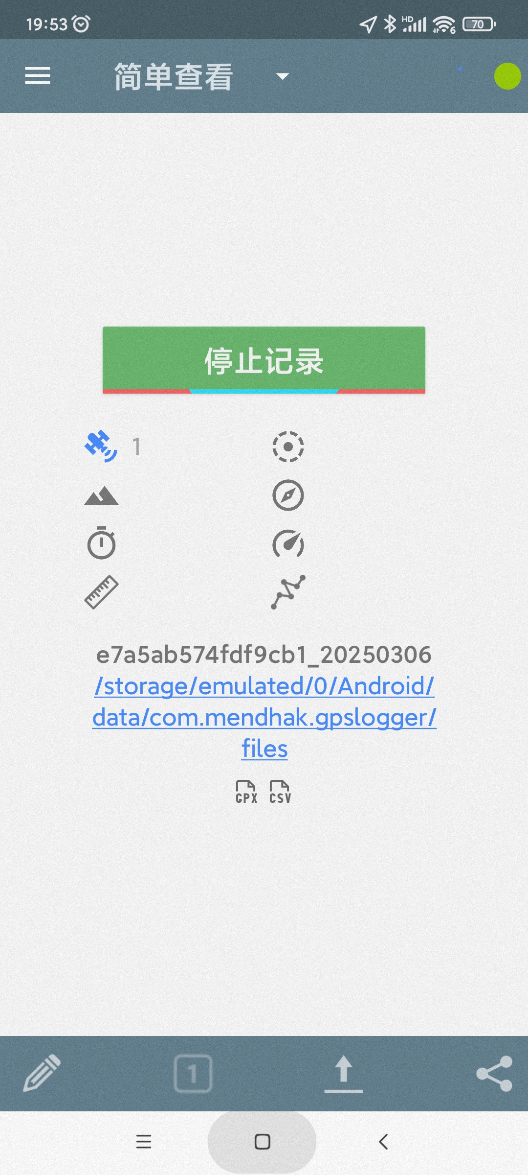
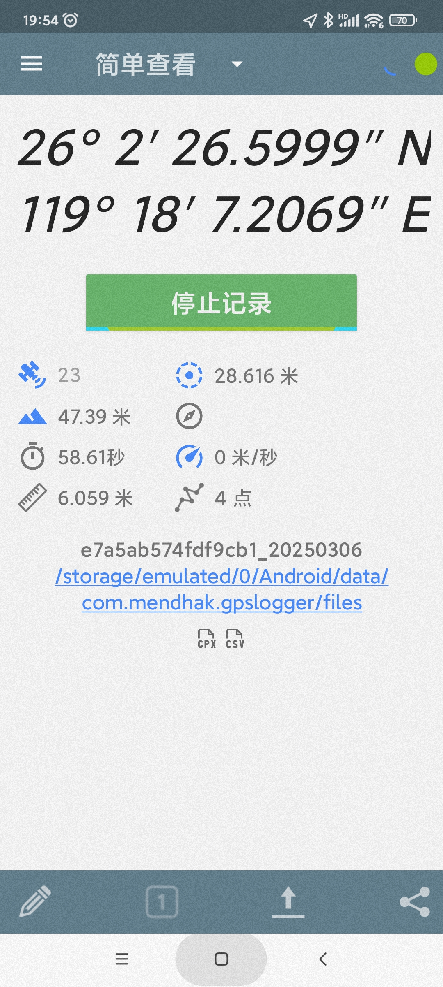
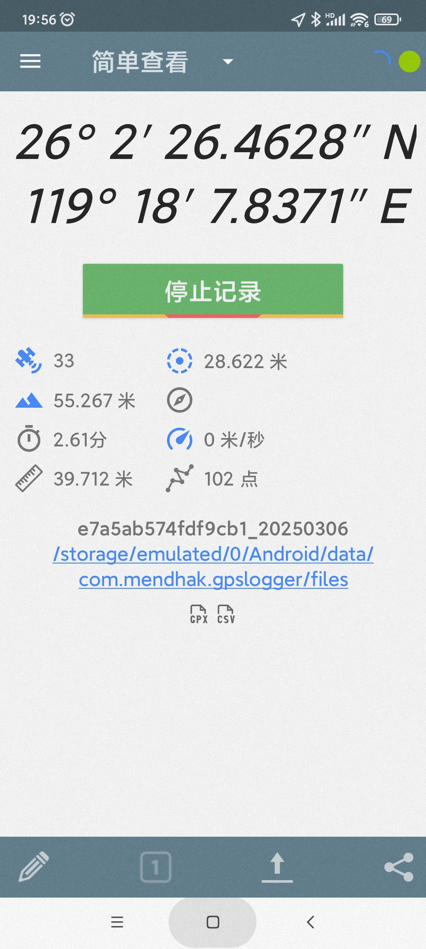
在固定的点上记录数据
在一个开阔地方（同一个点）进行连续数据采集，具体要求如下：
到选定的点后点击“开始记录” ，按设定的时间间隔采集，约采集100个点后停止记录。
在一个有部分遮挡的地方做同样的实验

Slide 8
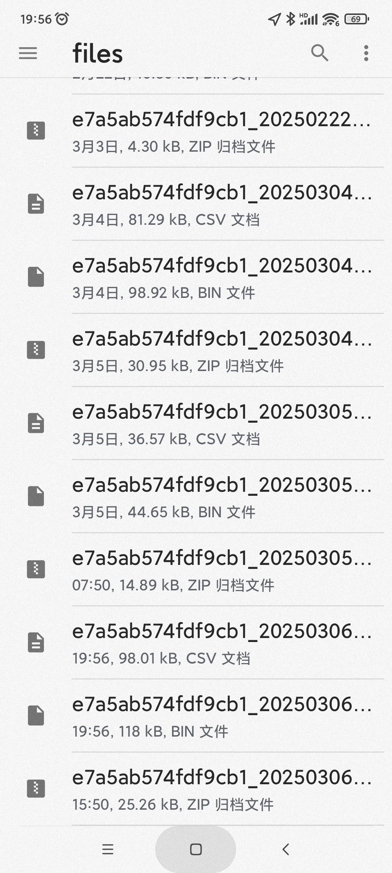
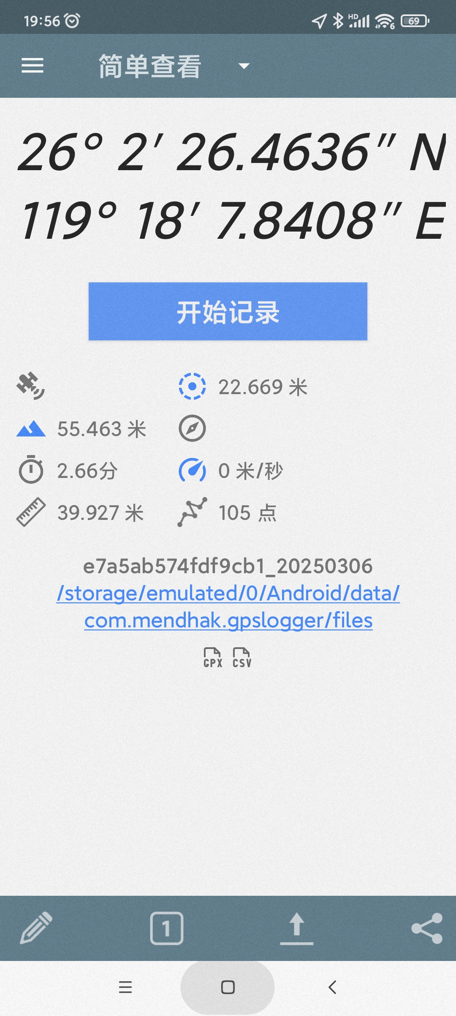
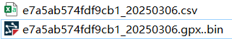
传输数据
*.CSV和*.gpx从手机传到电脑
需将*.gpx..bin从命名为*.gpx

Slide 9
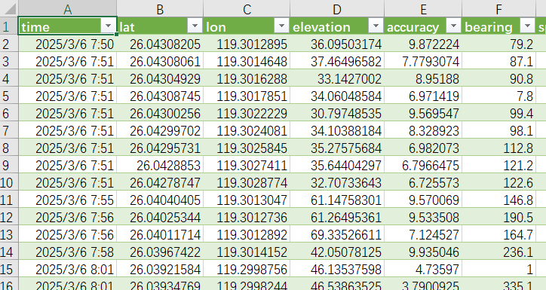
对数据坐标进行分析
CSV格式导入Excel分析
利用Excel的最大值、最小值、平均值、方差的函数分别求出两个位置的纬度（Lat）、经度（Lon）、高程（elevation）的最大值、最小值、平均值、方差值。
利用Excel绘制两个点的横坐标、纵坐标、高程的折线图（纵轴为坐标值，横轴为点顺序）

Slide 10
